Slide 1
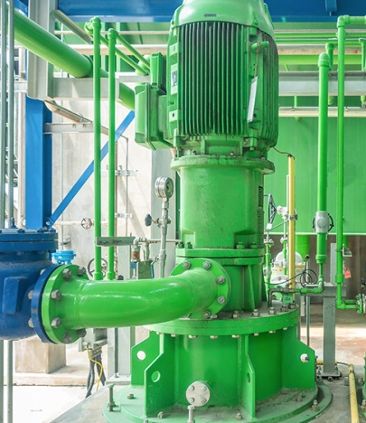
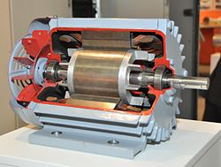
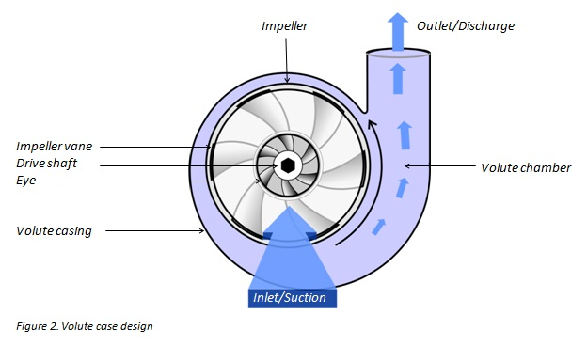
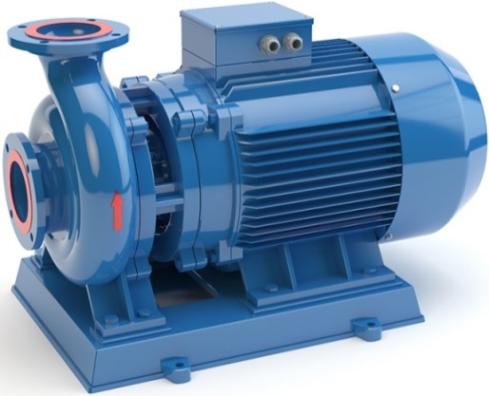
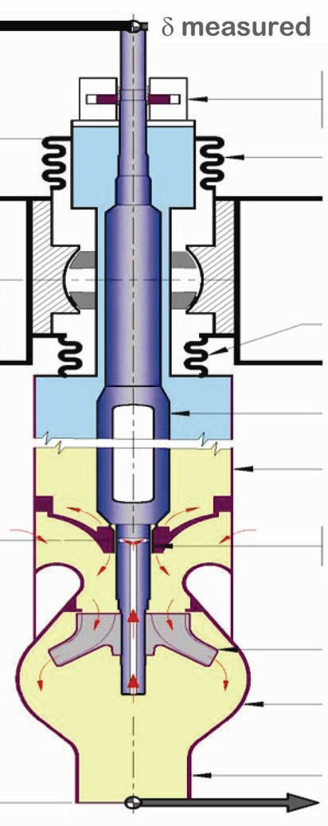
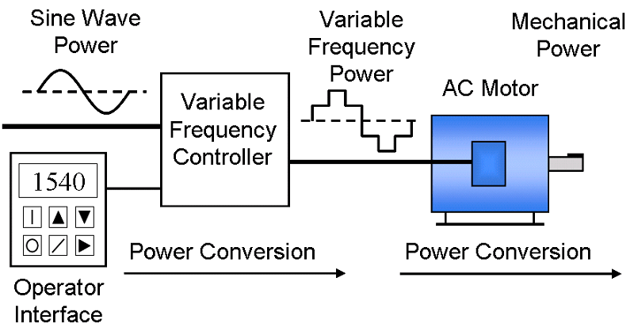
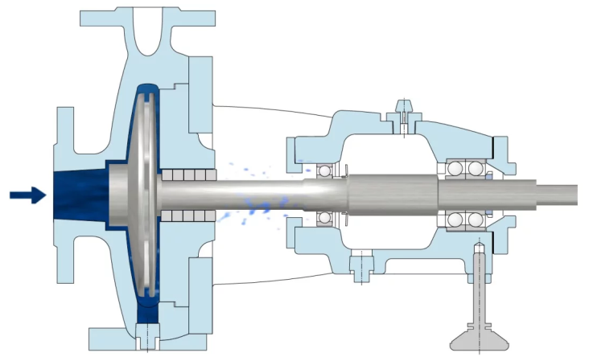
Acknowledgement Internet Images, available in Public Domain, have been used in many Slides of this Presentation. Some of the Images have also been Modified/Superimposed. Used only for Academic Purpose/Understanding.
Takeaways :
The State Transition Matrix
Conceptualizing an Observer
Conceptualizing a Stochastic Estimator
Lecture-10A

Slide 2
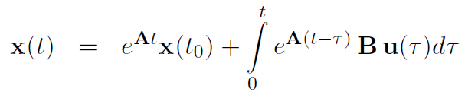

Review : General Solution of the State Equation

Slide 3
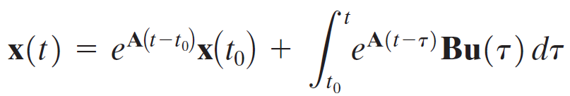
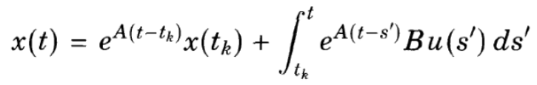


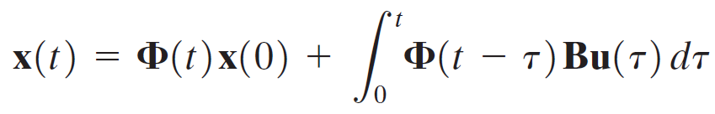
Review : Discretizing the State Equation

Slide 4



Properties of the State Transition Matrix

Slide 5
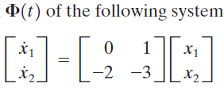
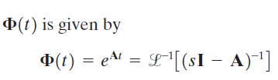
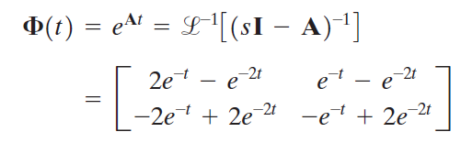


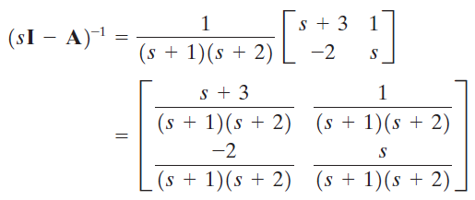
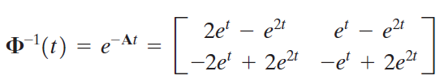
State Transition Matrix

Slide 6
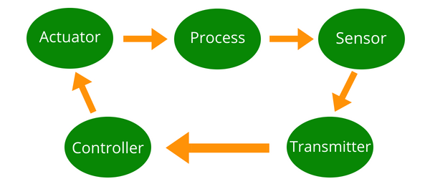
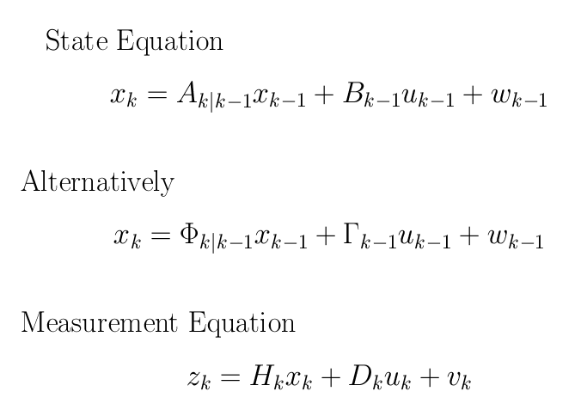
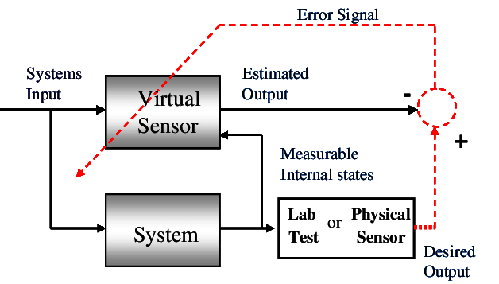
Why Estimate ?
System
Internal
Variables
Estimated States/
Virtual Measurements
INPUT
OUTPUT

Slide 7
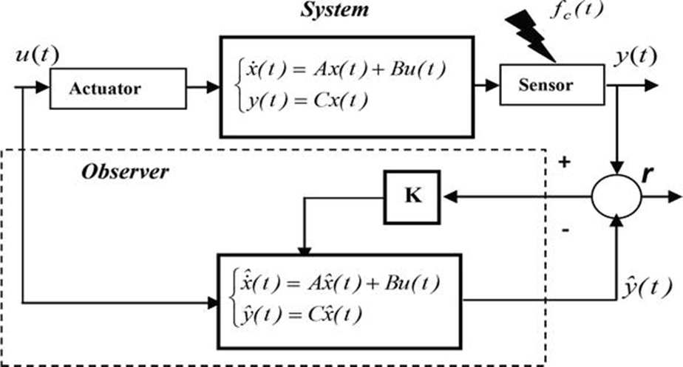
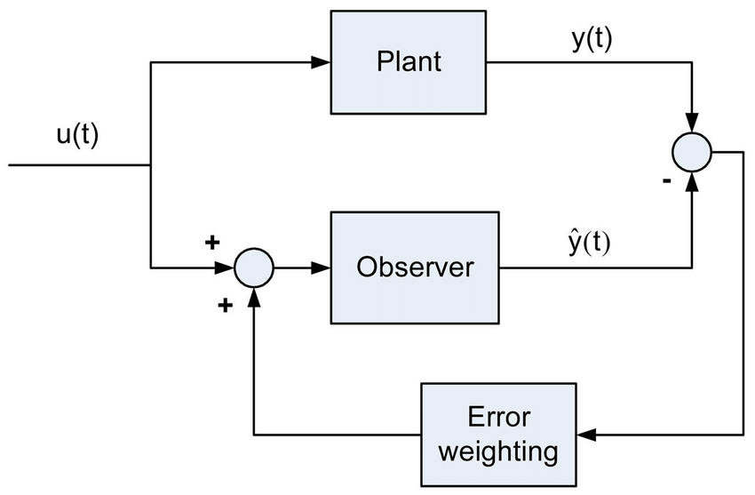
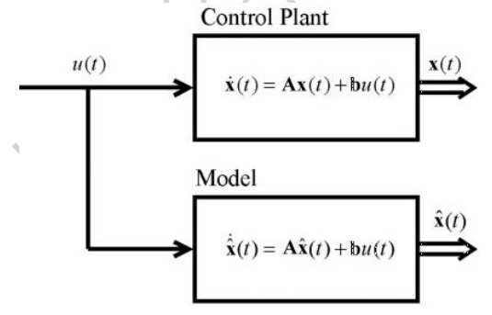
Conceptualizing an Observer Design
Plant
x(k+1) = Ax(k) + Bu(k)
y(k) = Cx(k) + Du(k)
U(k)
Y(k)
Observer
ξ(k+1) = Fξ(k) + Gy(k) + Hu(k)
Estimated State

Slide 8
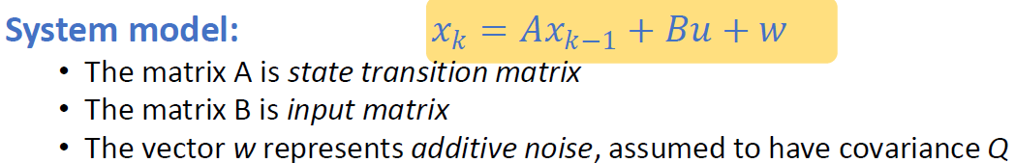
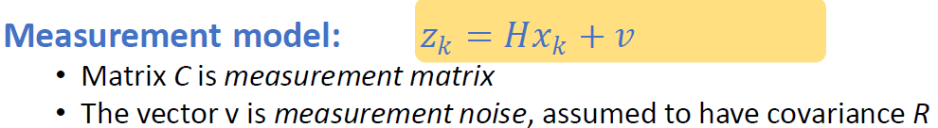
Extending the Observer Concept to a Stochastic Estimator

Slide 9
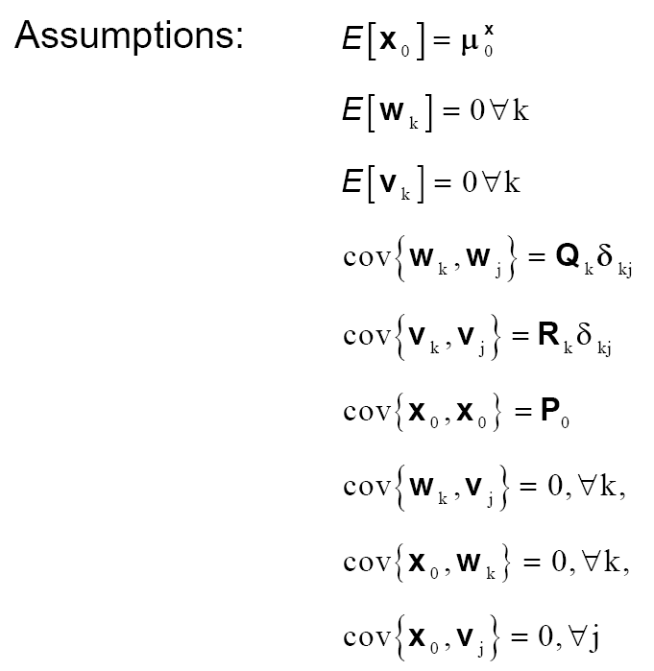
System Dynamics with Forcing Function & Noise
Assumptions

